Slide 1
Instruction Formats
(Lecture 24)

Slide 2
Instruction Formats
A computer will usually have a variety of instruction formats. Instruction in computers comprises groups called fields.
Operation code field specifies the operation to be performed like addition.
Address field which contains the address of the operand or may contain register address (Operands residing in processor registers are specified with a register address. A register address is a binary number of k bits that defines one of 2^k registers in the CPU. Thus a CPU with 16 processor registers R0 through R15 will have a register address field of four bits. The binary number 0101, for example, will designate register R5).
Mode field which specifies how operand or effective address can be determined.

Slide 3
Instruction Formats
Instruction is of variable length depending upon the number of addresses it contains. Generally, CPU organization is of three types based on the number of address fields:
Single Accumulator organization
General register organization
Stack organization
1. Single Accumulator organization:- This type of organization as already discussed in basic computer organization in which all operations are performed with an implied accumulator register. The instruction format in this type of computer uses one address field.
For example, the instruction that specifies an arithmetic addition is defined by an assembly language instruction as ADD X.
where X is the address of the operand. The ADD instruction in this case results
in the operation AC <--AC + M [X] where M[X] symbolizes the memory word located at address X.

Slide 4
Continue..
2. General register organization:- The instruction format in this type of computer needs multiple ( 2 or 3) address fields. Each address field may specify a processor register or a memory word. Thus the instruction for an arithmetic addition may be written in an assembly language as:
ADD R1 , R2 , R3
to denote the operation R 1 <--- R2 + R 3 . The number o f address fields in the
instruction can be reduced from three to two if the destination register is the
same as one of the source registers.
Thus the instruction ADD R1 , R2 would denote the operation R 1 <--- R 1 + R2. Thus the instruction MOV R1, R2 denotes the transfer R 1 <--R2 (or R2 <--R 1 , depending o n the particular computer).
(Transfer-type instructions need two address fields to specify the source and the destination.)
An instruction symbolized by ADD R1 , X would specify the operation
Rl <--R l + M [X]. It has two address fields, one for register R 1 and the other for the memory address X.

Slide 5
Continue..
3. Stack organization:- Stack organization would have PUSH and POP instructions which require an address field. Thus the instruction PUSH X will push the word at address X to the top of the stack and stack pointer is updated automatically.
Whereas operation-type instructions in stack organization do not need an address
field. This is because the operation is performed on the two items that are on top of the stack.
e.g. Instruction ADD in a stack computer consists of an operation code (ADD) only with no address field.
This operation has the effect of popping the two top numbers from the stack,
adding the numbers, and pushing the sum into the stack. There is no need to
specify operands with an address field since all operands are implied to be in
the stack.

Slide 6
Influence of the number of addresses
To illustrate the influence of the number of addresses on computer programs, we will evaluate the following arithmetic statement.
X = (A + B) • (C + D)
using 0, 1, 2, or 3 address instructions.
We will use the symbols ADD, SUH, MUL, and DIV for the four arithmetic operations; MOV for the transfer-type operation; and LOAD and STORE for transfers to an from memory and AC register. We will assume that the operands are in memory addresses A, B, C, and D, and the result must be stored in memory
at address X.

Slide 7

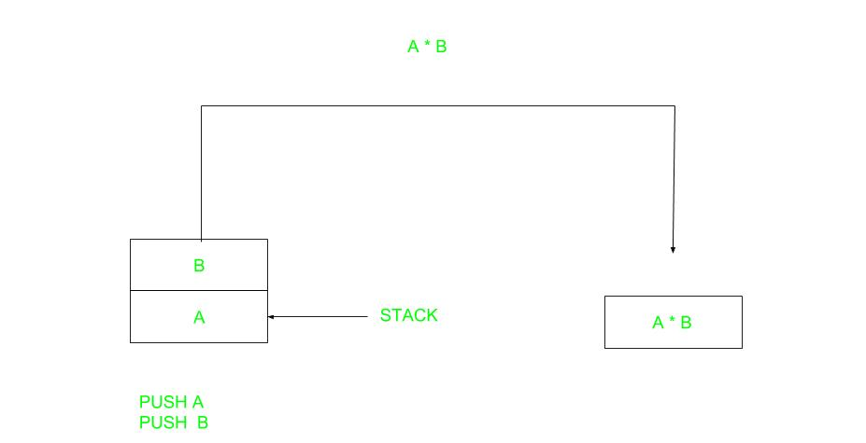
Continue..
Zero Address Instructions:
Solve using X = (A+B)*(C+D) expression
P U S H A T O S <- A
P U S H B T O S <- B
A D D T O S <- ( A + B )
P U S H C T O S <- C
P U S H D T O S <- D
A D D T O S <- ( C + D )
M U L T O S <- ( C + D ) • ( A + B )
P O P X M [ X ] <- T O S
Where TOS is Top of Stack

Slide 8

Contine..
One Address Instructions –This uses an implied ACCUMULATOR register for data manipulation. One operand is in the accumulator and the other is in the register or memory location. Implied means that the CPU already knows that one operand is in the accumulator so there is no need to specify it.

Slide 9
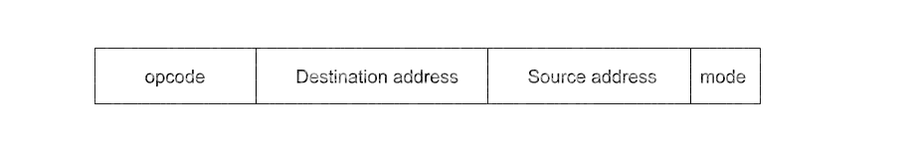
Continue..
Two Address Instructions –This is common in commercial computers. Here two addresses can be specified in the instruction. Unlike earlier in one address instruction, the result was stored in the accumulator, here the result can be stored at different locations rather than just accumulators, but require more number of bit to represent address. The first symbol listed in an instruction is assumed to be both a source and the destination where the result of the operation is transferred.

Slide 10
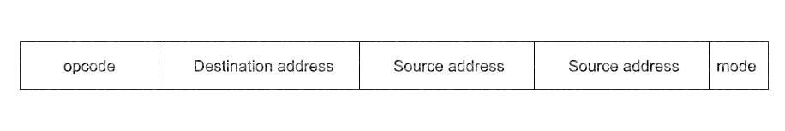
Continue..
Three Address Instructions –This has three address field to specify a register or a memory location. Program created are much short in size but number of bits per instruction increase. These instructions make creation of program much easier but it does not mean that program will run much faster because now instruction only contain more information but each micro operation (changing content of register, loading address in address bus etc.) will be performed in one cycle only.
An example of a commercial computer that uses three-address instructions is the Cyber 170. The instruction formats in the Cyber computer are restricted to either three register address fields or two register address fields and one memory address field.

